Slide 1
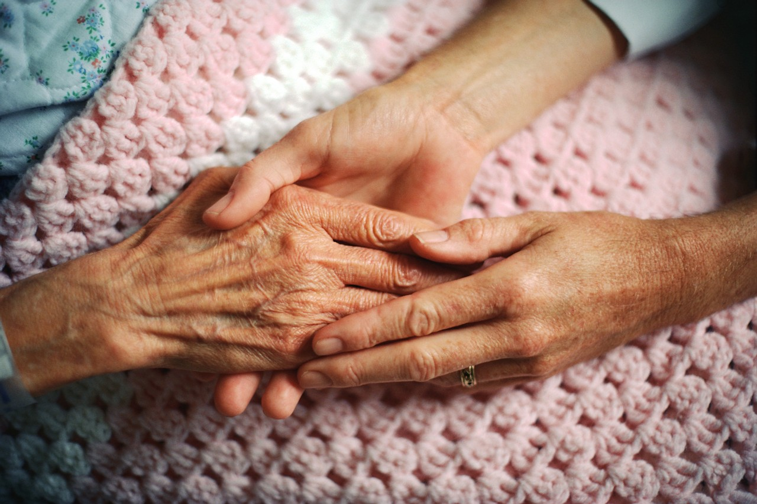
Safeguarding People
Raising Awareness
Philip Bell
John Bradshaw
This course has been designed for the Bracknell Forest
Safeguarding Board

Slide 2
Learning Objectives
Learners will:
Recognise safeguarding as everyone’s responsibility irrespective of the age of the individual at risk.
Understand the existing multi-agency safeguarding frameworks for both adults and children.
Review possible indicators of abuse and those factors that increase risk of harm to individuals.
Understand the importance of a person centred approach.
Know who to contact if concerned for another person’s welfare.

Slide 3
What is child safeguarding?
Safeguarding is everybody’s responsibility!
Working Together, 2018:
protecting children from maltreatment
preventing impairment of children's health or development
ensuring that children grow up in circumstances consistent with the provision of safe and effective care
taking action to enable all children to have the best outcomes.
Safeguarding is everybody’s responsibility!
Notes:
The facilitator should advise that Working Together 2018 is the statutory guidance that supports multi-agency working. It exists to highlight the expectations agencies at both a local and national level hold in regards to keeping children safe.

Slide 4
Working together to safeguard children:
A guide to inter-agency working to safeguard and promote the welfare of children (DfE 2018)
Key Principles:
safeguarding is everyone’s responsibility: for services to be effective each professional and organisation should play their full part
a child-centred approach: for services to be effective they should be based on a clear understanding of the needs and views of children.
Notes:
This slide enforces the key principles of the statutory guidance. It is useful for the facilitator to echo these messages as safeguarding is everyone’s responsibility irrespective of their organisation/ role within. The facilitator should add here that to provide the most effective services, a child’s needs and views must be clearly understood.

Slide 5
What is Adult safeguarding?
“Adult safeguarding” is working with adults with care and support needs to keep them safe from abuse or neglect.
Only became a statutory responsibility in 2014!
Applies regardless of who is funding the care and support (eg self funders or if funded by another LA but occurs within our area)
Applies in all settings apart from prisons and approved premises
Applies regardless of capacity
www.scie.org.uk
Notes:
To highlight that Adult Safeguarding has caught up with Children’s Services and is now a statutory responsibility for all agencies.
The key message is about keeping people safe and working with the individual to see what safe means to them.
Does Not only apply to people being funded by the Local Authority or Health.
Location dictates which Local Authority takes a lead on the Safeguarding e.g. A person funded to stay in a Bracknell care Home by South Tyneside so that they can be near their family would be supported by Bracknell regarding any safeguarding concerns. The funding Authority would be kept updated but not lead on the concern.
Just because somebody may lack capacity e.g. may have Dementia and unable to communicate their wishes, does not mean that the same protections are not put in place for them.
SCIE is the website for more comprehensive outlines on these topics

Slide 6

The Board is responsible for driving developments on adult and child safeguarding across Bracknell Forest.
The Board works with statutory, private and voluntary sector organisations to promote awareness of the safeguarding agenda.
Board membership includes: East Berkshire Clinical Commissioning Group (CCG), Thames Valley Police (TVP), Berkshire Health Foundation Trust (BHFT), Care Quality Commission (CQC), Probation, West London Mental Health Trust, Healthwatch, South Central ambulance Service (SCAS), Silva Homes.
https://bracknellforestsafeguarding.org.uk/
Notes:
The Bracknell Forest Safeguarding Board is a joint Board for Children and Adults.
It is an opportunity for Senior people from each organisation to discuss local Safeguarding issues. (Prevention and Actions after incidents)
Gives any communication sent out a more local focus. This helps targets specific categories of abuse that may indicate as higher within our community.
Helps us target training and Awareness for in House Staff Teams and Private Providers of care provision.
Creates a Multi-Agency approach to implementing and highlighting Safeguarding concerns.
A direct line to Senior decision makers means awareness raising and changes can be put in place swiftly.
Would decide on whether a Safeguarding Adults Review is required after an event/incident.

Slide 7
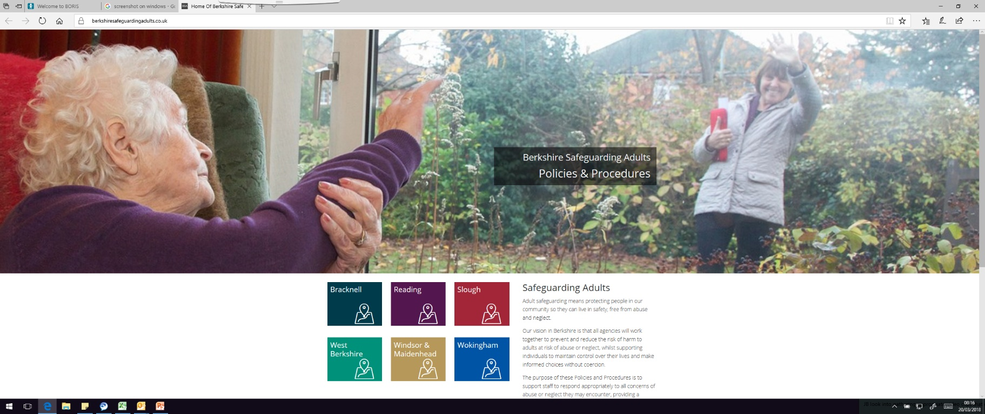
Berkshire Multi-Agency Safeguarding Adults Policy & Procedures
https://www.berkshiresafeguardingadults.co.uk/
Notes:
This is the link and screen shot to the Procedures.
These procedures provide contact details of each of the Berkshire Unitary Safeguarding Teams.
You click on the specific square of the Council you need to contact.
This also offers guidance on general Safeguarding good practice, and links together Safeguarding processes and procedures both Local and National.
Provides tools such as a Pressure Sore pathway.
Good to advise that each Agency has this link to hand within their organisation, perhaps an email link (many staff keep the link on their Desktop front screen)
Ideal for contacts and reference.
A very user friendly document.

Slide 8
Making Adult Safeguarding Personal
Is about having conversations with people about safeguarding situations in a way that enhances involvement, choice and control as well as improving quality of life, wellbeing and safety.
It is about seeing people as experts in their own lives and working alongside them. It is about collecting information about the extent to which this shift has a positive impact on people’s lives.
It is a shift from a process supported by conversations to a series of conversations supported by a process.
Notes:
Adult Safeguarding has “Making Safeguarding Personal” running through every aspect of it.
Having the person involved and their outcome wishes as much as possible is key.
Where somebody lacks Capacity it is about finding out their previous wishes. E.g. “I know Mum’s had a fall but the last thing Mum would of wanted would have been to go in to a Care Home.”
This then shapes the Action plan you develop. i.e. Is there a solution where this lady could be supported to live in her own Home, live in carer, support with medication, food prep, adaptions to the property. Therefore looking at the person, what is realistic with the resources available and not have a default approach of what is the easiest option(Care Home) for the Council/Organisation/family.

Slide 9
Safeguarding Principles of the Care Act
•
Notes:
info taken from berks procedures
http://berksadultsg.proceduresonline.com/pdfs/safeg_summ_010415.pdf
Highlights the 6 Safeguarding principles stated in the Care Act.
Links into the Person Centred nature of Adult Safeguarding.
Following these principles ensures Agencies stay focused on the person.
Powerful statements that do not presume that this is already a ‘common sense’ approach already.
Risk Framework tool follows these principles too - Bracknell Forest Safeguarding Board - Multi-Agency Risk framework

Slide 10
Safeguarding Principles (continued)

Slide 11

The definition of safeguarding adults is set out in the statutory guidance:
“Safeguarding means protecting an adult’s right to live in safety, free from abuse and neglect. It is about people and organisations working together to prevent and stop both the risks and experience of abuse or neglect, while at the same time making sure that the adult’s wellbeing is promoted including, where appropriate, having regard to their views, wishes, feelings and beliefs in deciding on any action.”
Notes:
This statement embodies all of the Safeguarding Principles.
You will notice a theme of Making Safeguarding Personal runs through everything.

Slide 12

This must recognise that adults sometimes have complex interpersonal relationships and may be ambivalent, unclear or unrealistic about their personal circumstances.
Notes:
People we work with will occasionally be ‘befriended’ due to the nature of their vulnerabilities as perpetrators will see them as an ‘Easy target’.
These ‘friendships’ will often be very important to the person we are supporting. There is a balancing act to keeping the person safe and them not pushing us away because we are telling them who they can or cannot have friendships with. E.g. “I still want to see my Grandson, I just want him to stop asking for money.” “I’d like to see Bob but not the other people he hangs around with.”
Families too can be the exploiters/abusers. There is a fine line to tread when the person we are working with may not want to “get anybody in trouble” or potentially criminalise a loved one.
Following the Safeguarding principles and working with the person gives us the best chance of engaging with them in a way that will keep them safe.

Slide 13
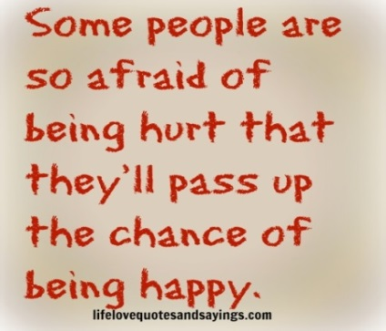
People have complex lives and being safe is only one of the things they want for themselves. Professionals should work with the adult to establish what being safe means to them and how that can be best achieved... “DH, March 2016 (paras 14.7- 14.8)
Notes:
Links into the previous slide that Making Safeguarding approaches gives us the best chance of a positive outcome for the person.
Multi Agency working means the person has a number of options to keep themselves safe when they are ready to engage.
If a person lacks capacity then how they have historically lived their lives can help us shape any protections that are put in place.

Slide 14
Mental Capacity, Safeguarding and Making Safeguarding Personal (MSP)
Mental capacity is frequently raised in relation to adult safeguarding and challenges many professionals
The MSP summary by Lawson et al. (2013) highlighted sound practice and competence in applying the Mental Capacity Act (2005) in safeguarding adults to ensure that people who lack capacity are offered a person centred safeguarding service with appropriate advocacy to support them.
Notes:
The Mental Capacity Act has 5 principles.
Principle 1: Assume a person has capacity unless proved otherwise.
Principle 2: Do not treat people as incapable of making a decision unless all practicable steps have been tried to help them.
Principle 3: A person should not be treated as incapable of making a decision because their decision may seem unwise.
Principle 4: Always do things or take decisions for people without capacity in their best interests.
Principle 5: Before doing something to someone or making a decision on their behalf, consider whether the outcome could be achieved in a less restrictive way.
Once you've decided that capacity is lacking, use principles 4 and 5 to support the decision-making process.
The MCA links into Person centred approaches. Following these principles you are giving the person every opportunity to make their decisions in a way they choose regardless of their capacity.
Regardless of whether a person has Capacity or lacks capacity Independent Advocacy should be always be available to the individual being supported..

Slide 15
What are the different types of abuse?
Physical
Sexual
Financial & Legal
Neglect or omission
Discriminatory
Psychological
Institutional
Self Neglect
Modern Slavery
Sexual Exploitation
Domestic Abuse
Notes:
These are the categories of Abuse covered under Care Act Section 42 Adult Safeguarding.
With the introduction of the Care Act Sexual Exploitation, Self Neglect, Modern Slavery anf Domestic Abuse were added to the previous guidance list covered within Adults.
Each of these categories has its own set of characteristics and abuse may cover more than one category. E.g Physical and Psychological behaviours could be evident in Domestic Abuse.
Brief Definition.
Physical abuse: Physical harm to an individual's body from, for example, hitting, restrictive practices and medication. Untreated or unexplained injuries including cut, bruises, burns, bites, hair loss etc.
.Sexual abuse: Sexual relationships or activities that an individual does not or cannot consent to.
Financial abuse: Use of an individual's money or possessions without permission. Includes theft, fraud, scamming, coercion, self-serving involvement in an individual's financial affairs.
Neglect or Omission: Other People responsible for an individual not seeing to their basic needs such as nutrition or hygiene either deliberately or inadvertently.
Discriminatory abuse: Individuals being treated differently due to personal traits such as age, gender, race, sexual orientation etc.
Psychological: Abuse includes 'emotional abuse' and takes the form of threats of harm or abandonment, deprivation of contact, humiliation, rejection, blaming, controlling, intimidation, coercion, indifference, harassment, verbal abuse (including shouting or swearing), cyber bullying, isolation or withdrawal from services or support networks.
Institutional/organisational abuse: When an organisation's needs are put above an individual's needs e.g. telling an individual that they have to go to bed at a certain time,Inflexibility
Poor staff knowledge and training
Self-neglect: An individual being unable to see to their own basic needs, such as nutrition or hygiene. Can also be linked to those who live in a cluttered environment
Modern slavery: Individuals being forced into a life of slavery, human trafficking, domestic servitude or forced labour.
Sexual exploitation: This is the sexual abuse of an adult in exchange for attention, affection, food, drugs, shelter, protection, other basic necessities and/or money, and could be part of a seemingly consensual relationship. There can also be links to grooming.gr
Domestic abuse: Threats, violence and abuse between individuals that are family members or in an intimate relationship. Domestic abuse can be recognised by the signs of one or more of the other types of abuse or neglect
ooming.

Slide 16
Who might be an adult at risk of harm?
A person who:
Is over 18
Has care and support needs
Is experiencing, or is at risk of, abuse or neglect and
Is unable to protect themselves because of their care and support needs.
Care Act 2015
Could somebody be temporarily vulnerable?
Notes:
The Care Act Section 42 definition of Adult Safeguarding.
A person needs to meet these criteria to receive support under Section 42 of the Care Act.
This will be the test to see if a person meets eligibility to have support from the Local Authority. Safeguarding referrals will be triaged against these guidelines.
However if a person does not meet all of these 4 criteria it does not mean they will not be offered support and guidance. It just means they will not be supported through the section 42 process.
There are alternatives such as The Risk Framework Tool that can be used if this was the case.
In answer to “could somebody be temporarily be vulnerable?” the answer is yes.
Use examples when we All have to rely on others (regardless of Care needs) and how this puts us at the trust of others. E.g. following a minor operation, when we have a cold, even putting your car in for repair. Anytime we are reliant of others we could be open to being exploited.

Slide 17
People with care and support needs are not inherently vulnerable, but they may come to be at risk of abuse or neglect. A person with care and support needs may be:
an older person or a child.
a person with a physical disability, a learning difficulty or a sensory impairment
someone with mental health needs, including dementia or a personality disorder
a person with a long-term health condition
someone who misuses substances or alcohol to the extent that it affects their ability to manage day-to-day living
a person who is socially isolated or without support networks
living in inappropriate accommodation
experiencing financial difficulties
This is not an exhaustive list.
Notes:
Note: new care act information that highlights potential types of vulnerabilities.
http://www.scie.org.uk/care-act-2014/safeguarding-adults/adult-safeguarding-practice-questions/index.asp?utm_campaign=5505870_27+March+SCIE+ebulletin++&utm_medium=email&utm_source=SCIE&utm_sfid=003A000000blc3HIAQ&utm_role=Other&dm_i=4O5,3A0CU,UW4FG,BQDA0,1

Slide 18
Exercise: Indicators of Abuse
Kicking Threats on social media Restricted movement Fear Explicit photos posted online Medication misuse Subservience The person tells you Personal hygiene deteriorates Person is prevented from visiting friends (1) | Urine infection Malnutrition Stealing food Regimented routines Withdrawal Person cannot access their bank account Bruising Increased confusion Threatening emails Medical needs not met (2) | Humiliation Isolation Teasing Poor care Fearful of authority Phone given as a gift by a new partner Pressure sores Intimidation Losing possessions (3)
Notes:
This Slide shows the various indicators of abuse and how they can cover a number of the abuse categories.
Safeguarding is not always clear cut and these indicators show some of the subtle signs that abuse may be occurring.
Being vulnerable does not mean you cannot protect yourself. However some of these indicators clearly show how a vulnerable could be exploited or manipulated due to being reliant on others.
e.g. not being able to do their own shopping, medication mis-use, regimented routines becoming the norm.
Activity for Students: This chart is Split into 3 sections. Divide the students into 3 teams and give them a section each.
Ask them to match the indicators to the Safeguarding categories of abuse..
Each indicator may link to more than one abuse type.
Allow ten minutes.
Then get each Team to feedback on their linking of indicators and ask them for their reasoning and thought process.
This should highlight the importance of always keeping the potential of Safeguarding in mind. However unlikely it may appear on first viewing a situation that involves these indicators may be hiding a more abusive situation/motive. Intentionally or unintentionally .

Slide 19
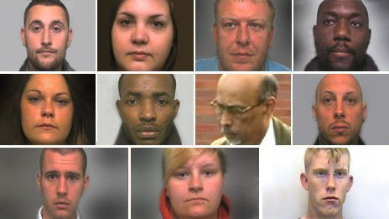
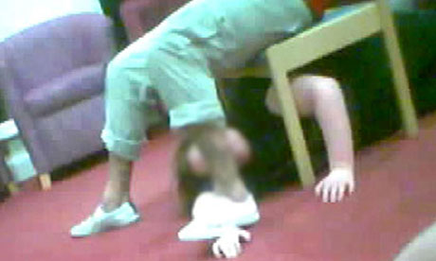
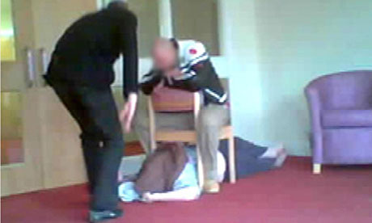
Case Study:
Winterbourne View 2010
Physical and psychological
institutionalised abuse including water
torture, wrestling patients to the floor,
power ‘games’
‘The only language they understand
is force’
Serious Case Review:
Notes:
http://www.theguardian.com/society/2011/jun/01/care-home-abuse-ministers-move
http://www.southglos.gov.uk/Pages/Article%20Pages/Community%20Care%20-%20Housing/Older%20and%20disabled%20people/Winterbourne-View-11204.aspx
2010.
Winterbourne View Hospital was a private hospital for adults with learning disabilities and autism, mostly accommodating patients who
Were detained under the provisions of the Mental Health Act 1983
An undercover reporter secured employment as a support worker at Winterbourne View Hospital.
During his five weeks as a Castlebeck Ltd employee he filmed colleagues tormenting, bullying and assaulting patients.
Fundamental principles of healthcare ethics such as Respect and justice were absent at Winterbourne View Hospital.
Makes for horrific viewing. Even at this time developments within Care gave Authorities a confidence that this type of abuse could not be carried out un-noticed.
Led to changes to the way inspections are carried out and formation of the CQC focused on the person rather than the paperwork.
Government used this incident to announce a policy of closer of these large scale Hospital Private institutions.
Staff sentenced to two and a half years in prison.

Slide 20
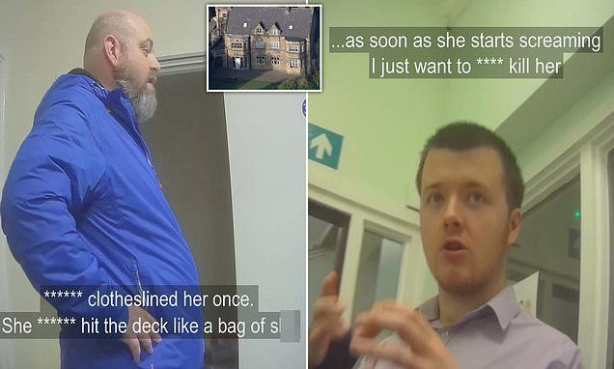
Whorlton Hall 2019
Undercover BBC filming shows staff intimidating, mocking and restraining patients with learning disabilities and autism at
Whorlton Hall, County Durham.
Experts said the culture was deviant at the privately-run NHS-funded unit with evidence of "psychological torture".
A police investigation has been launched and 16 staff suspended.
Notes:
2019
Sadly 9 years on undercover filming by Panorama exposed another similar situation as Winterbourne at Whorlton Hall.
Highlights the need for Agencies to monitor and speak up about bad practice.
Our staff are our eyes and ears that will uncover poor practice/individual abuse.
Don’t be complacent. A case of we never thought a Winterbourne View would ever happen again and then this happened.
Always feel confident to challenge suspicions of bad practice. We are all experienced Professionals so if something is telling you something doesn’t feel right raise it with the Local Authority, CQC, Safeguarding Board.

Slide 21
MSP - Feedback in Practice
“But she’s not my sister”
Safeguarding meeting highlighted gentleman's sister was not his sister. He told us she had been making financial decisions for him for years. Any spending by her was never questioned as she had been fooling people they were related.
“The support I received was excellent. I feel safe. Am I happy that this happened? Not really, but I know it is the right thing for me to do.”
Feedback from a person who took the decision to move out of his marital home due to domestic violence.
“I know the pot holes in the road are not the fault of the hospital transport service, but consequently being on the vehicle longer than necessary means driving through these then impacts on me. After spending nearly 3 hours on the ambulance I felt just lousy and pretty sore by the time I get home. “
This meeting was held in the hospital whilst the gentleman received his dialysis. Consequently all parties involved could be present and changes to the transportation implemented immediately.
Notes:
Showing the importance of Making Safeguarding Personal and involving the person.
The first shows how if we hadn’t of spoken to the person directly without the influence of his ‘sister’ the abuse would have continued.
The lady concerned was actually the wife of an ex-work colleague.
The Gentleman had a stroke and the ‘sister’ had taken advantage of the gentleman’s new found reliance on her for light domestic support and social company.
This charade of being related had been carried out for so long nobody in this gentleman’s circle of acquaintances ever questioned that his ‘sister’ would not be doing anything that wasn’t in his best interests.
Second Highlights that sometimes if a person chooses a route that keeps them safe it does not mean they automatically become “Happy”. Additional input after the Safeguarding can also be provided to help the person get back on track.
Third case highlights how having the person and the right agencies that can make changes all together can make instant improvements. Hearing the persons voice is very powerful.

Slide 22
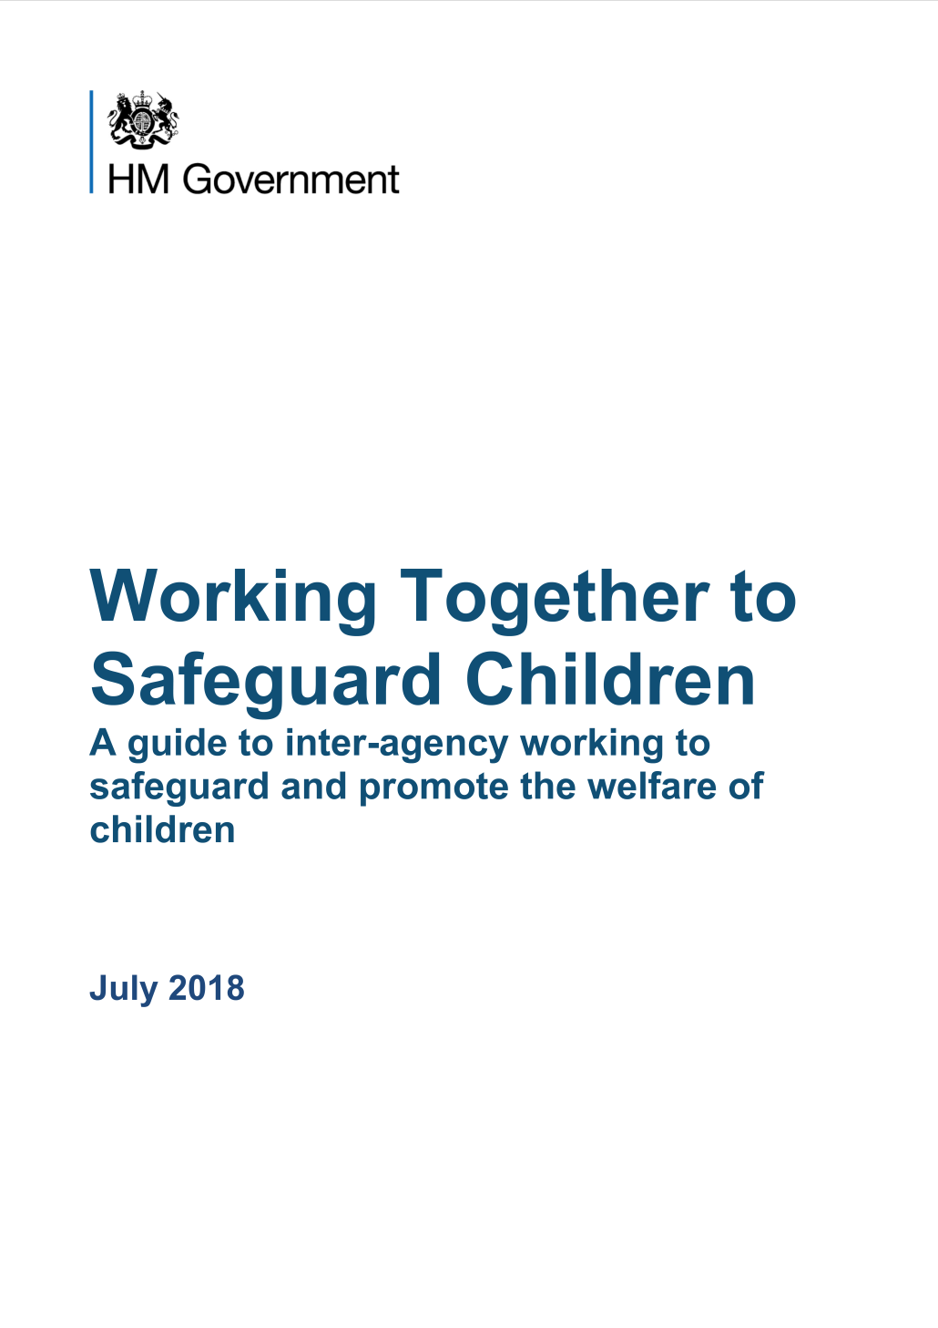
Whilst it is parents and carers who have primary care for their children, local authorities, working with partner organisations and agencies, have specific duties to safeguard and promote the welfare of all children in their area:
The Children Acts of 1989 and 2004 set out specific duties: section 17 of the Children Act 1989 puts a duty on the local authority to provide services to children in need in their area, regardless of where they are found….
These duties placed on the local authority can only be discharged with the full co-operation of other partners, many of whom have individual duties when carrying out their functions under section 11 of the Children Act 2004….
Notes:
This slide sets out the expectations for safeguarding children nationally. It is useful to assert that parents and carers have primary responsibility for the care and safety of their children. This said, certain statutory services such as Children’s Social Care and the Police will have specific safeguarding responsibilities that are enshrined in law. These It is also useful to highlight that the a local authority can only discharge their duties regarding children in need of services with full co-operation of partner agencies.

Slide 23
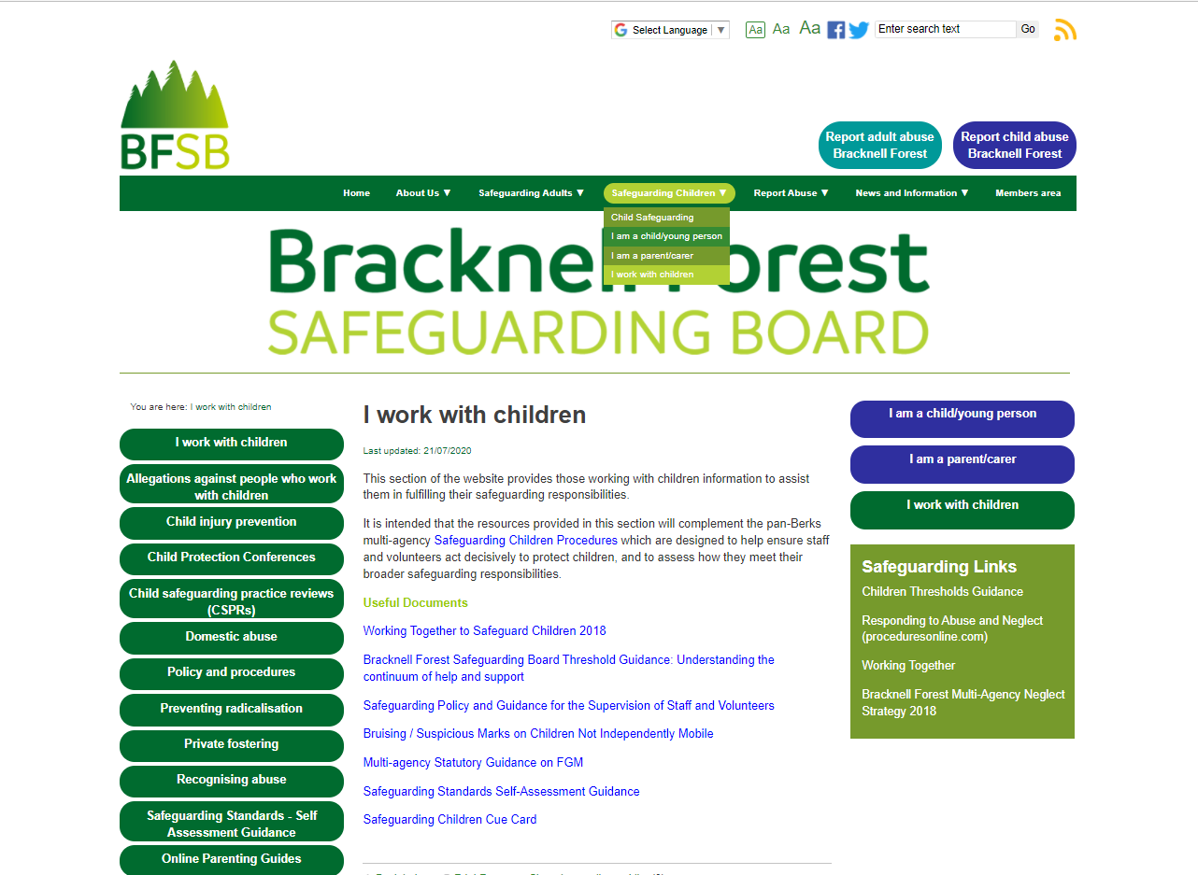
Notes:
This is the relevant page on the Bracknell Forest Safeguarding Boards website (BFSB) which allows practitioners across agencies to view local multi-agency procedures. On this page there are links to the pan berks Policy & Procedures website as well as links/access to other useful documents and sites.
Similar information for adults can be found by following the ‘I work with adults’ drop down on the safeguarding adults tab.

Slide 24
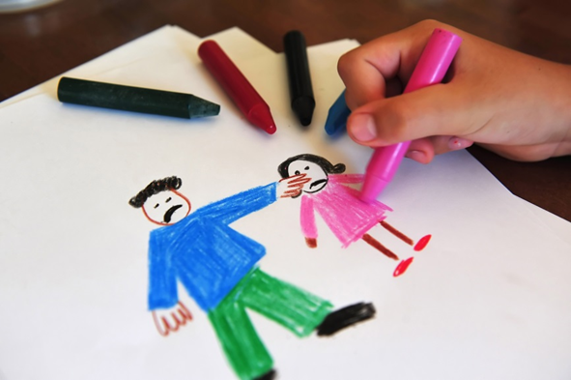
Abuse and Neglect
Forms of harm:
Physical Abuse
Emotional Abuse
Sexual Abuse
Neglect
Notes:
Though these are the four primary forms of abuse, exploitation harm can also exist for children. Child Sexual Exploitation (CSE) is a form of sexual abuse where coercion and often gift and status are exchanged for sexual gain. Children can be open to multiple forms of abuse and exploitation harm and so professionals will need to really understand a child’s lived experience and offer proactive services that maximise their effectiveness and de-escalate the risk of harm.

Slide 25
What Children Need to Thrive
Security
Stability
Consistency
Emotional Support
Love
Education
Positive Role Models
Structure
Notes:
This slide builds on the assumption that a child’s basic survival needs are being met e.g. shelter, food, clothing, medical care and protection from harm. The facilitators could talk here about Maslow’s hierarchy of Needs: www.simplypsychology.org/maslow.html
These 8 essential requirements come from research undertaken in Colorado and remind that care is not about the goods given to children but rather the emotional investment and boundaries provided by their parents/carers: https://www.childrenscolorado.org/conditions-and-advice/parenting/parenting-articles/what-children-need/#:~:text=The%20eight%20things%20kids%20need%20to%20thrive&text=Kids%20must%20feel%20safe%20and,care%20and%20protection%20from%20harm.
This slide can also be used to reinforce that children of all ages have a global need for predictability via their care givers. Facilitators could also remind learner that although the boundaries surrounding a child’s care needs will need to change as they grow so to develop the independence skills they need, the key principles of predictability should not.

Slide 26

Working Together – What do children & young people want from practitioners?
Vigilance Understanding & Action
Stability Respect
Information Explanation
& Engagement
Support Advocacy
Notes:
This slide represents the feedback given by children to inform the writing of Working Together, the statutory guidance for the multi-agency safeguarding of children. Facilitators could inform learners here of the importance of engaging with children, using language and explanation that is clear for them to understand when they and their family are in receipt of services. Professionals should continue to check with children that they understand why they are receiving the help provided, using language that is age appropriate. Children should always be encouraged to speak out if they are feeling uneasy or unsafe.

Slide 27
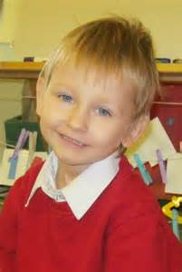
Learning from Tragedy – Daniel Pelka
Daniel died, aged 4, as a result of a head injury.
He was the victim of physical and emotional abuse
and neglect.
Learning Points:
Domestic abuse is always a child protection issue
Seek the direct views of the child
There should never be sole reliance on a parent’s
explanation of events about family relationships
and associated risks
Professional accountability for record keeping,
timely reports and recording of key actions
When faced with significant and complex concerns about
a child’s welfare, it is essential that professionals
“think the unthinkable”.
Notes:
Daniel was killed by his step-father in 2011. Like so many national reviews to have gone before him, Daniel and his two siblings were well known to services. His family were of Polish heritage (both his birth parents and step father), Daniel was a scapegoat within his family with his step-father often harming Daniel to relieve his own frustrations. His mother experienced complex mental health issues and was an alcohol misuser. Her relationship with Daniel’s step-father and several of her previous partners were domestically abusive. Daniel was starved and suffered cruel, sadistic abuse at the hands of his step-father and had a mother who was unable to protect him, colluding with the abuse experienced. These are features within family functioning known to increase risk to children. Daniel was not a hidden child and attended school for 6-months prior to his death (though attendance poor). He was known to health service, the police, children’s social care and housing, yet no professional was able to understand his lived experience and the abuse that was happening thus preventing them from taking the necessary action to keep him safe. Following a Serious Care Review (now termed Child Safeguarding Practice Review), multiple professional failings were found. Agencies each held significant risk information which if collated could have painted a considerable picture of Daniel’s life, the risks posed to him. Professionals should be encouraged here to think the unthinkable and reminded that abuse can happen to children at the hands of the very people appointed to keep them safe, whether parents, extended family, friends or professionals.

Slide 28
Additional Vulnerabilities in Children
Children that are under school age and particularly under 1 year old.
Repeat domestic violence within the household
Parental substance misuse
Chronic ill health e.g. parental mental health issues, child with disabilities
Families with multiple problems.
Young people with communication problems
Young carers
This is not an exhaustive list
Notes:
This slide can be used to remind learners that although any child of any age can be subject to abuse and harm, there are factors that can increase their vulnerability as highlighted above. Immobile children and those with complex disabilities are a particularly high risk group as often unable to recognise risk, verbalise or able to remove themselves from a danger situation. They also require comprehensive care from their care givers. Reference paper: as follows https://assets.publishing.service.gov.uk/government/uploads/system/uploads/attachment_data/file/182095/DFE-00108-2011-Childrens_Needs_Parenting_Capacity.pdf

Slide 29
Impact of Child Abuse
Can affect all aspects of health, development, well-being & self-esteem
Long term health problems
Physical damage
Relationships
Employment
Behaviour
Angry acts
Substance abuse
Self harm or suicide
This is not an exhaustive list
Notes:
Child abuse can affect survivors in many ways. This list is not exhaustive but should be used to communicate the ways in which the trauma of such an experience can manifest. Reference paper: https://www.ncbi.nlm.nih.gov/pmc/articles/PMC1494926/

Slide 30
What to do if you’re worried a child is being abused – Advice for Practitioners (DfE 2015)
Remember do not investigate yourself
Collect information available to you
Discuss with your manager
Refer as appropriate
Understand own accountability
You can consult with Named Professionals, within your agency or Social Services for advice
Notes:
The facilitator should remind learners that they should never investigate the potential abuse of a child but should gather all information available to them, write this up in the child’s language wherever possible, and report to their manager without delay. A representative of the professionals service should then contact the Multi-Agency Safeguarding Hub to communicate the concern held and seek advice on how best to proceed.

Slide 31
Making a Child Safeguarding Referral
The Multi-Agency Safeguarding Hub (MASH) will take all the new safeguarding contacts /enquiries to the Local Authority.
The MASH will send all relevant referrals that meet Children’s Social Care criteria for an assessment to that team.
01344 352 005
(Follow up in writing within 48 hours. You can also phone this number to ask for a consultation with a social worker.)
MASH@bracknell-forest.gov.uk
Out of Hours Team 01344 351999 (When the office is closed and the issue cannot wait until it re-opens)
If a concern is raised about a professional or volunteer’s conduct towards a child, the Local Authority Designated Officer (LADO) should be contacted on: 01344 351572
Notes:
This slide should be used to explain the role of the Multi-Agency Safeguarding Hub (MASH). Facilitators should also highlight the local MASH contact information and clarify with learners that if a concern is raised about a professionals conduct towards a child, the Local Authority Designated Officer (LADO) should always be alerted and their advice obtained. Organisations should not investigate without seeking such advice.

Slide 32
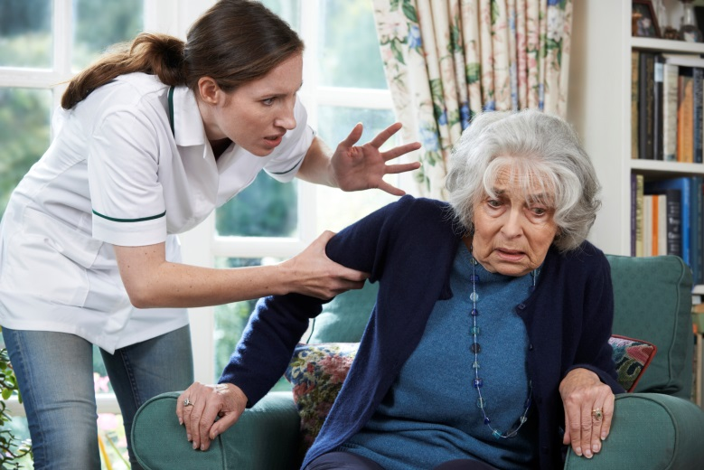
Whistleblowing
Raising concerns at work should be seen as part of normal day-to- day good working practice
Use organisation policy first
https://www.wbuk.org/ (Whistleblowers UK)
ACAS
Notes:
Organisations should promote an open culture where staff are encouraged to speak up about poor practice. This can be in Team Meetings or One to One Supervisions.
Poor practice is not always intentional.
Care provision has changed dramatically over the past 10 years. People in Care establishments have far more complex support needs than they used to.
Good practice of the past could now be seen as neglectful e.g. moving and handling techniques for a person who is semi-independent are very different for somebody who needs to transfer from a bed to a wheelchair.
People are being supported to live in the Community and their own Homes more. Spouses, Family and Friends may be working hard 24hrs/7 days a week with little respite. This may often be in silence as they do not feel the person being cared for would want ‘Social Services’ involved. This may lead to you noticing un-intentional abusive practice going on. E.g. locking Mum’s door to stop her walking out. Dad sleeping in his chair because he can’t manage the stairs.
Support in the above 2 cases would be pro-active and look to empower the person and the Staff/Families.
If the abuse is more sinister then we may be the only ‘voice’ for that person to highlight the abuse that is taking place.
After Winterbourne View why would anybody want to protect these preparators?
Concerns can be raised anonymously.

Slide 33
Contact Information
EMERGENCY
If an individual is at risk of immediate harm call the emergency services on 999.
INITIAL CONTACT
Bracknell Forest Council 01344 351500 (all safeguarding concerns are then directed to the appropriate duty safeguarding manager)
Out of Hours Team 01344 351999 (When the office is closed and the issue cannot wait until it re-opens)
Notes:
For Adults these are the first line of contact to the police or the Local Authority. if you have a Safeguarding Concern.
01344 351500 is the Monday to Friday, 9am to 5.30pm telephone number.
01344 351999 is the out of hours number for the whole of Berkshire.
Each organisation should have its own procedures of how to progress a Safeguarding concern..

Slide 34
CONTACT DETAILS
Safeguarding Adults Development Workers - responsible for supporting front line teams in delivering effective and person centred responses to safeguarding concerns, identifying trends and monitoring/ensuring best practice:
Dionne D’Sa - 01344 351506
John Bradshaw - 01344 351617
Local Police 101
Care Quality Commission (CQC) - 03000 616161
Notes:
These are contact numbers if you require a less urgent Safeguarding response, guidance or advice regarding an Adult Safeguarding matter.
The CQ can offer advice around Care Establishments and Care Providers. These include Hospitals, Care Homes, GP practices.

